Slide 1
Basic icons 50
Alerts & Notifications 10

Slide 2
Chat & Messages 15
Mails 30

Slide 3
Users 25
Files 25

Slide 4
Folders 25
Weather 10
Bookmark & Tags 10

Slide 5
Gestures 15
Arrows 45

Slide 6
Emoticons 35

Slide 7
Hardware 35
Electronics 20

Slide 8
Education 25
Medical 30

Slide 9
Finance 15
Holiday & Travel 20

Slide 10
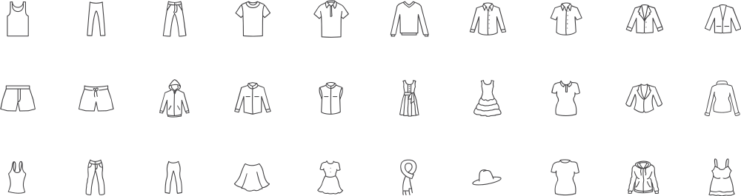
Clothes 30
World monuments 10
Tools 15

Slide 11
Transport 60

Slide 12
Restaurant 25
Furniture 20

